Slide 1


cosmetics
Let Your Beauty Shine Through

Slide 2







Team Members
Ahmed Gomaa
Ahmed Ayman
Aliaa El-Sepay
Salma Essam
Mona Ashraf

Slide 3





Agenda
1
INTRODUCTION
5
SSIS
2
6
DATASET & EXTRACTION
DATA VALIDATION & DAX
7
3
DATABASE DEVELOPMENT
DASHBOARD & REPORTING
4
DATA WAREHOUSE
WEB APP
8

Slide 4
Introduction
This project focuses on analyzing cosmetics sales and customer data to support better decision-making. It provides insights into product performance, customer preferences, and skin types using interactive dashboards. The goal is to improve marketing, personalize recommendations, and boost overall sales through data-driven strategies.

Slide 5

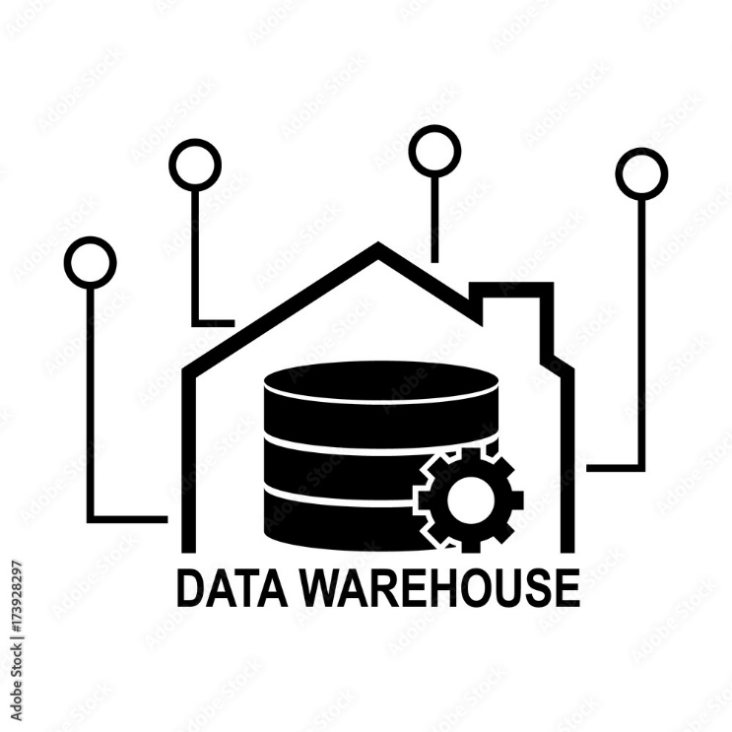




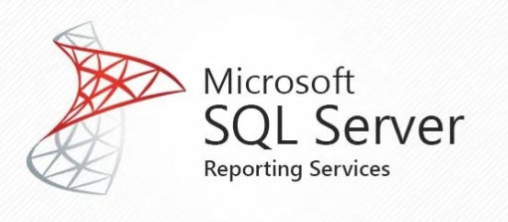

DATA SOURCES
DWH
ANALYTICS
ETL

Slide 6
Dataset & Extraction
Dataset & Extraction – Detailed Process:
Data Extraction
Data Cleaning & Validation
Data Transformation & Integration
Loading to Staging

Slide 7
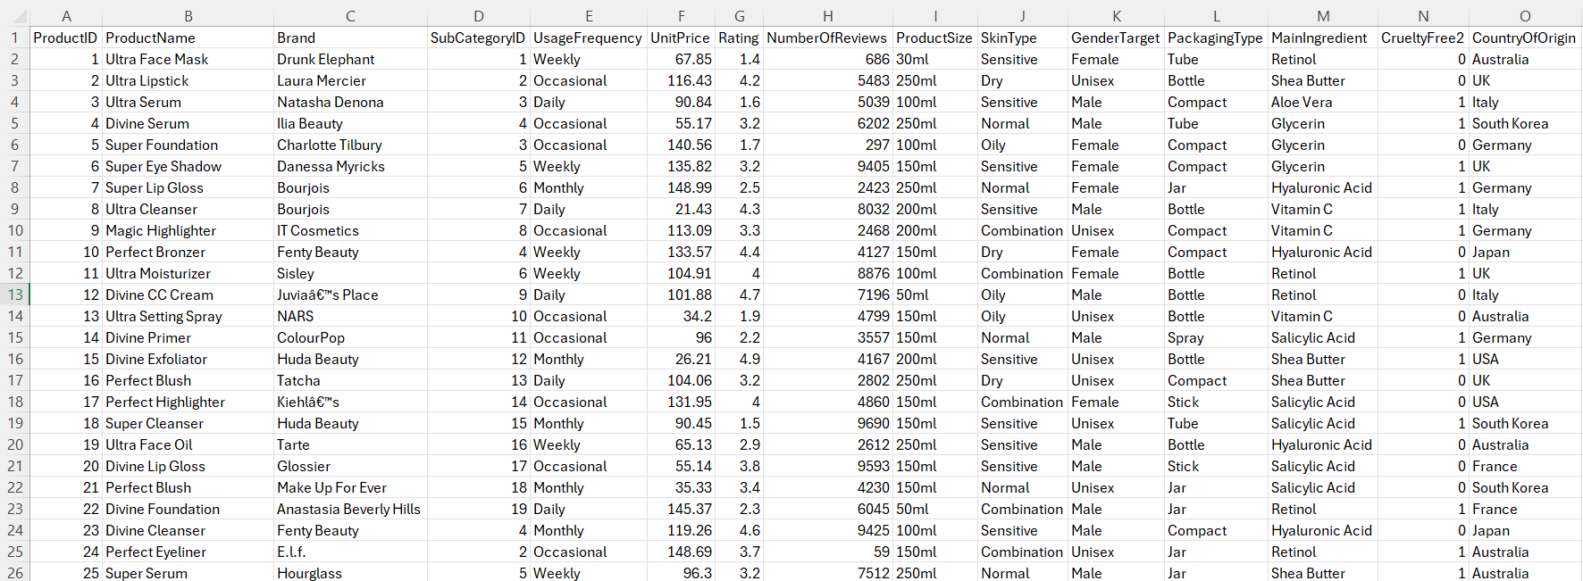
Dataset & Extraction
1.Product Table

Slide 8
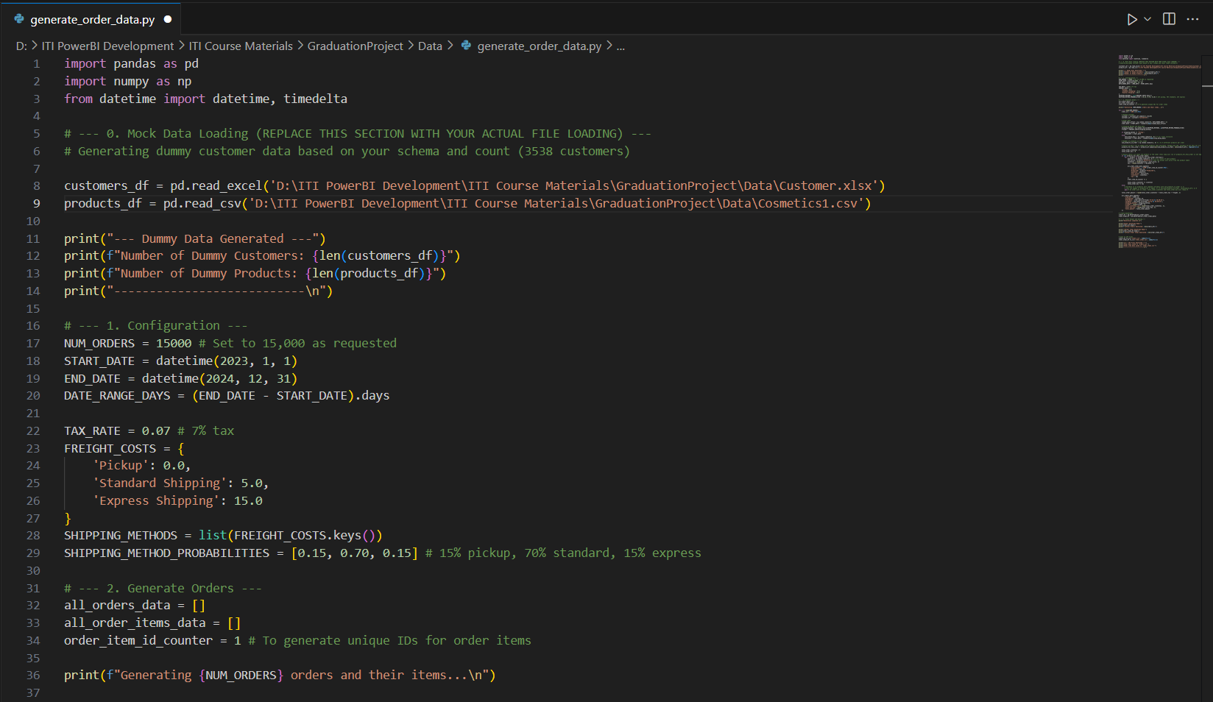
Dataset & Extraction
2.Data Generate

Slide 9
Database Development
A structured relational database was built using SQL Server to support analysis and reporting. Core entities like Customers, Products, Orders, and Branches were connected using primary and foreign keys. Normalization and indexing were applied to ensure performance, scalability, and data integrity for integration with reporting tools.

Slide 10
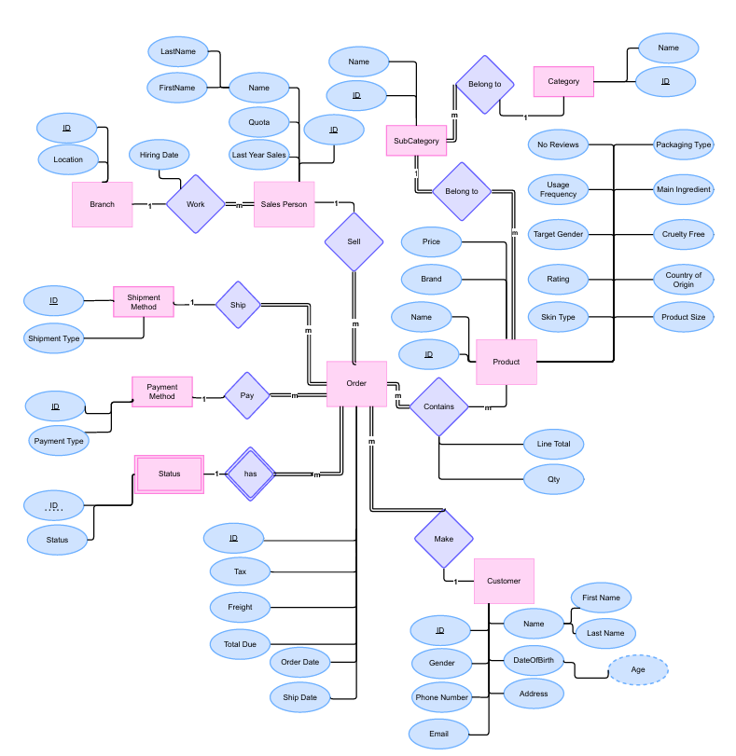
Database Development
1.ERD

Slide 11
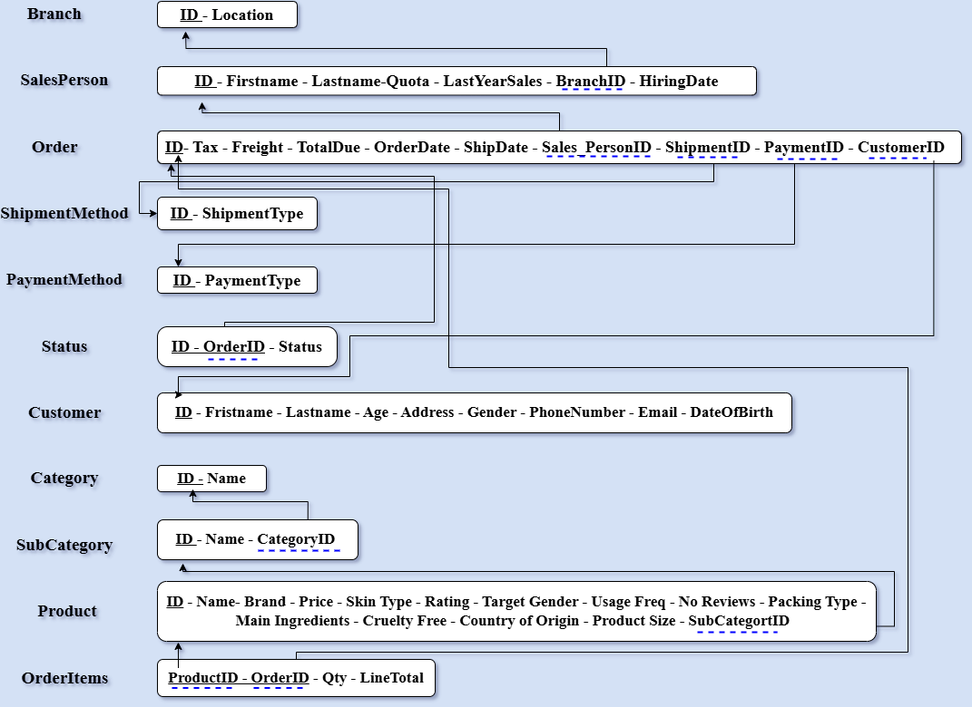
Database Development
2.Mapping

Slide 12
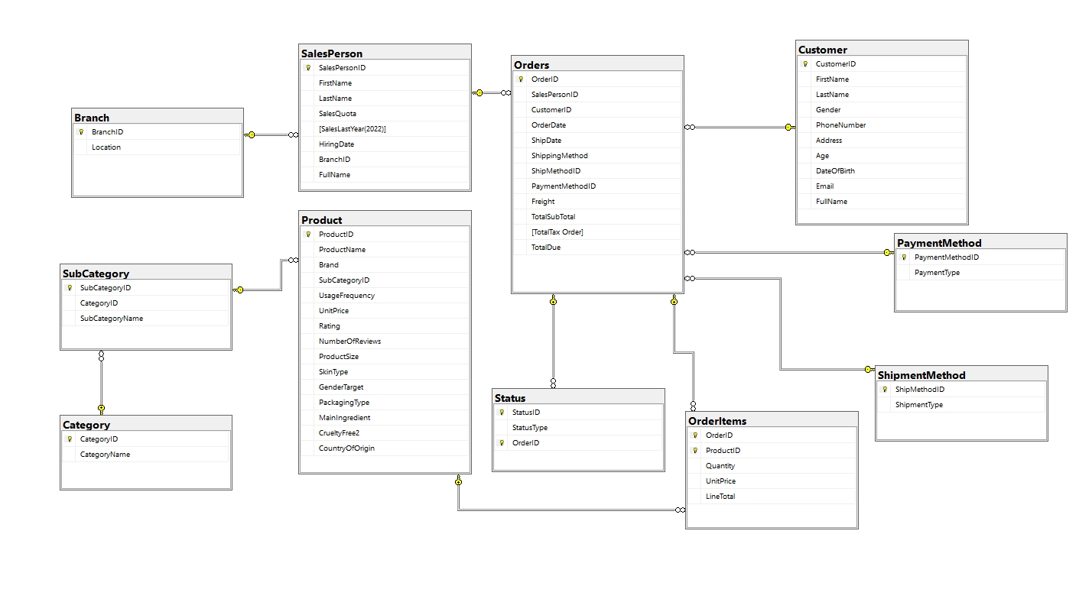
Database Development
3.Database Schema

Slide 13
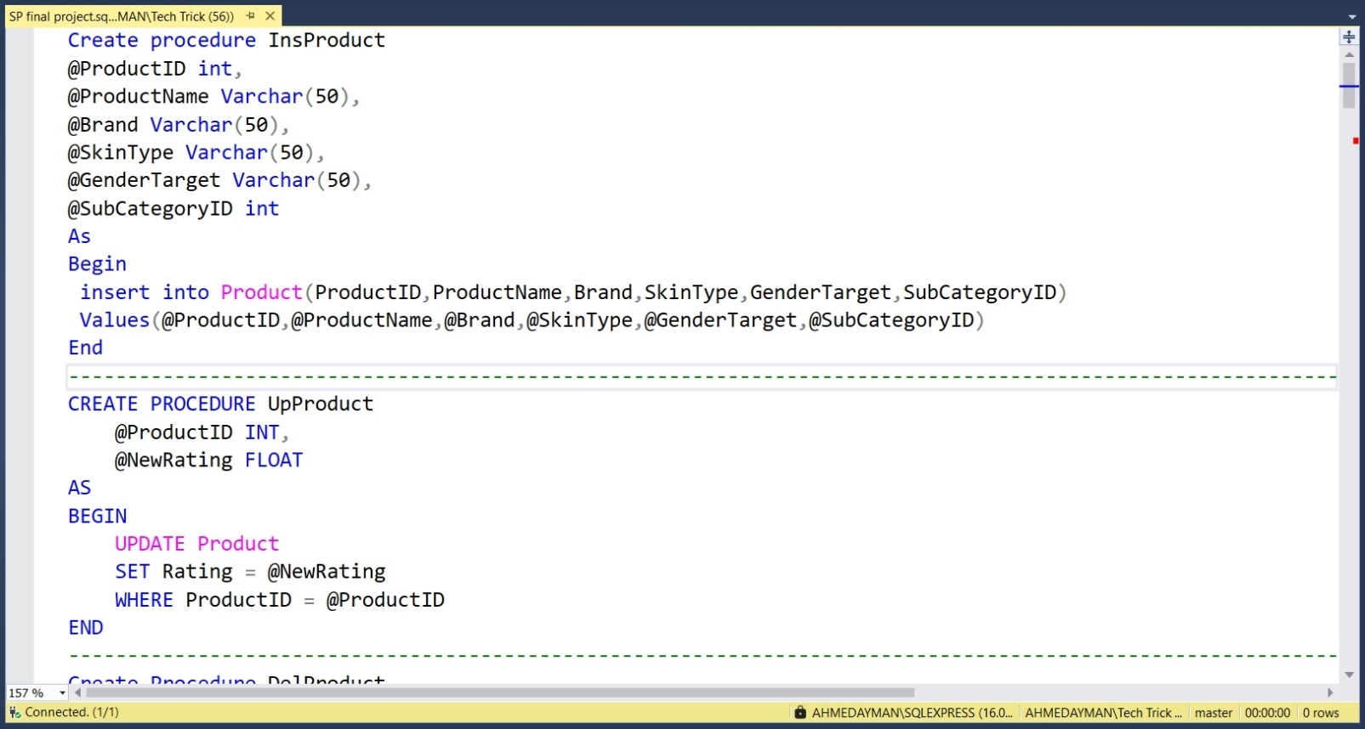
Database Development
4.Stored Procedure

Slide 14
Datawarehouse
The data warehouse follows a Snowflake schema centered on the FactSales table, linked to normalized dimension tables such as Customer, Product, Category, and Date. This structure reduces redundancy, ensures data integrity, and enables flexible, detailed analysis in Power BI, including drill-downs by category, skin type, and branch performance.

Slide 15
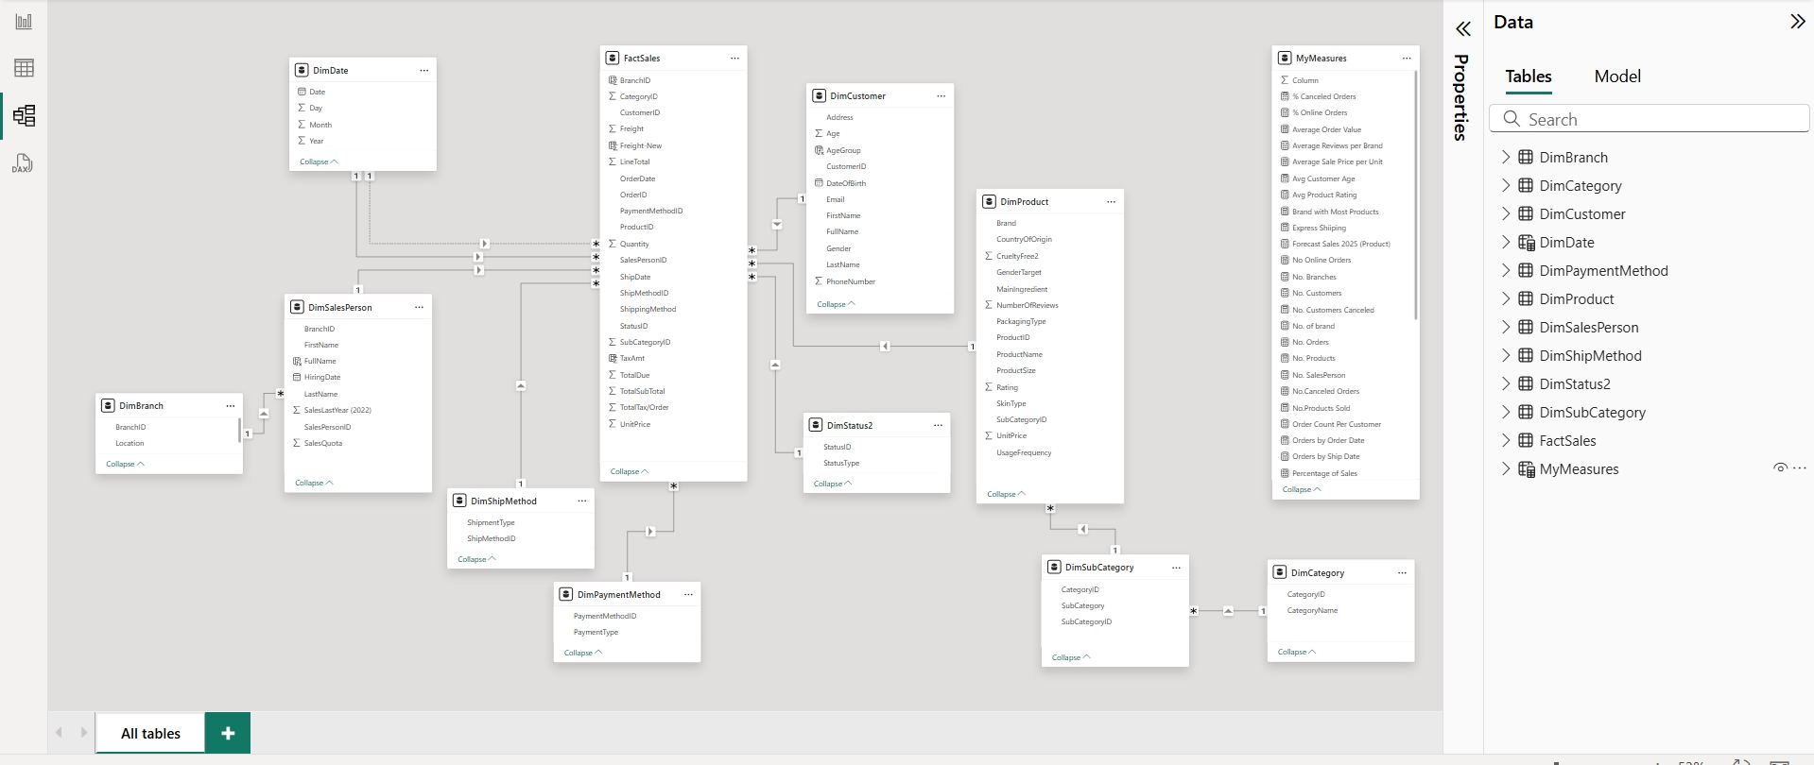
Datawarehouse

Slide 16
SQL Server Integration Services (SSIS)
SSIS was used to build an automated ETL process that extracted, cleaned, and loaded data from multiple sources into the central database. It supported operations as integrating tables from Excel, CSV, and system-generated files. Data Flow Tasks and Control Flows were used to ensure consistency, accuracy, and repeatability—preparing the data for reliable use in Power BI dashboards and SSRS reports.

Slide 17
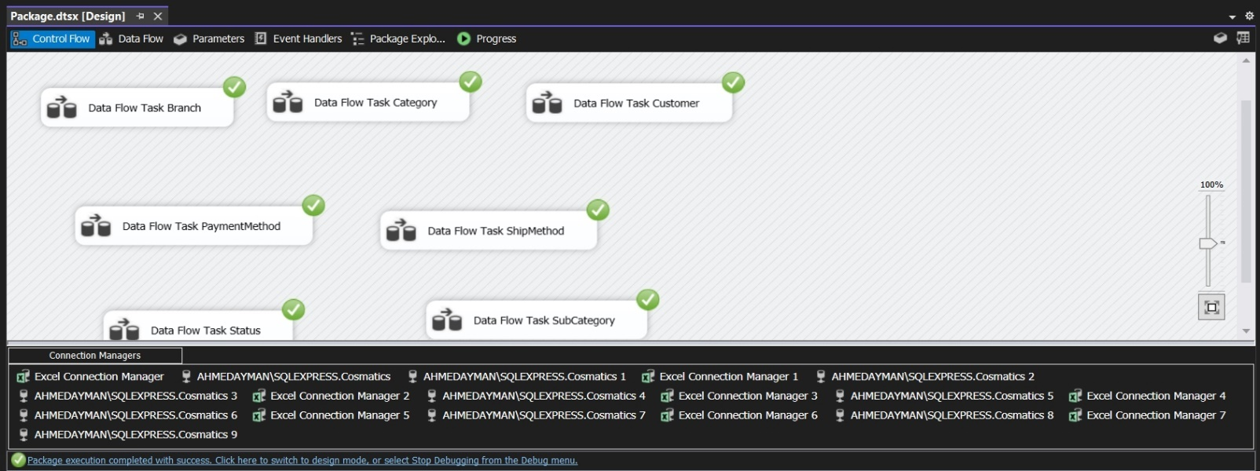
SQL Server Integration Services (SSIS)

Slide 18
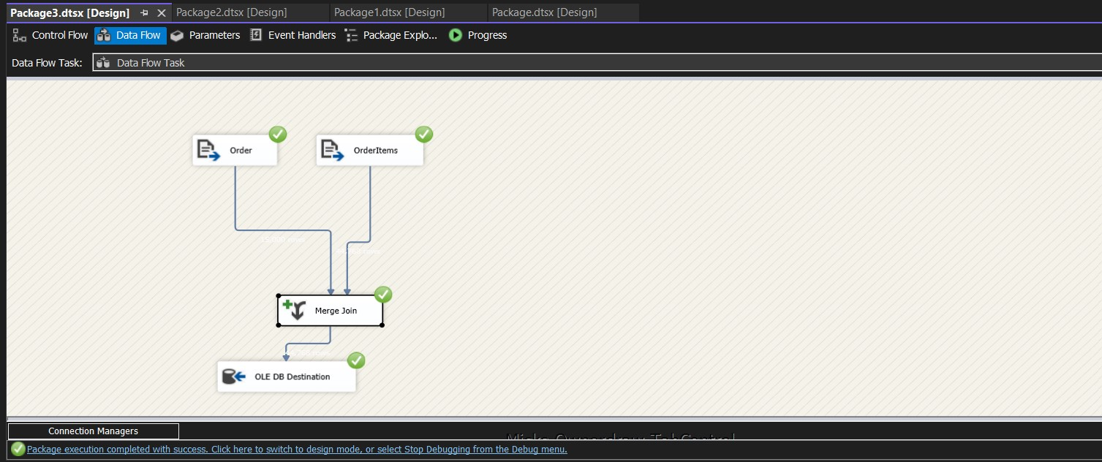
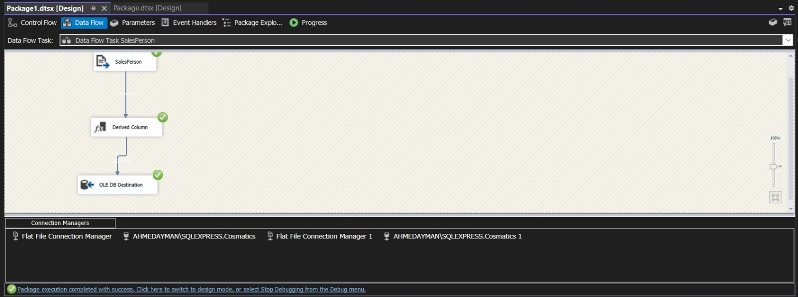
SQL Server Integration Services (SSIS)

Slide 19
Data Validation & DAX
Data validation was performed to ensure accuracy and consistency. This included handling and correcting data types, and cross-checking totals across tables. Together, DAX and validation ensured the reliability of insights and enhanced the overall quality of reporting.
DAX (Data Analysis Expressions) was used in Power BI to create calculated columns, measures, and KPIs for advanced analytics, such as sales growth, product ranking, and customer segmentation. Custom DAX logic enabled dynamic filtering, time intelligence, and interactive visualizations.

Slide 20
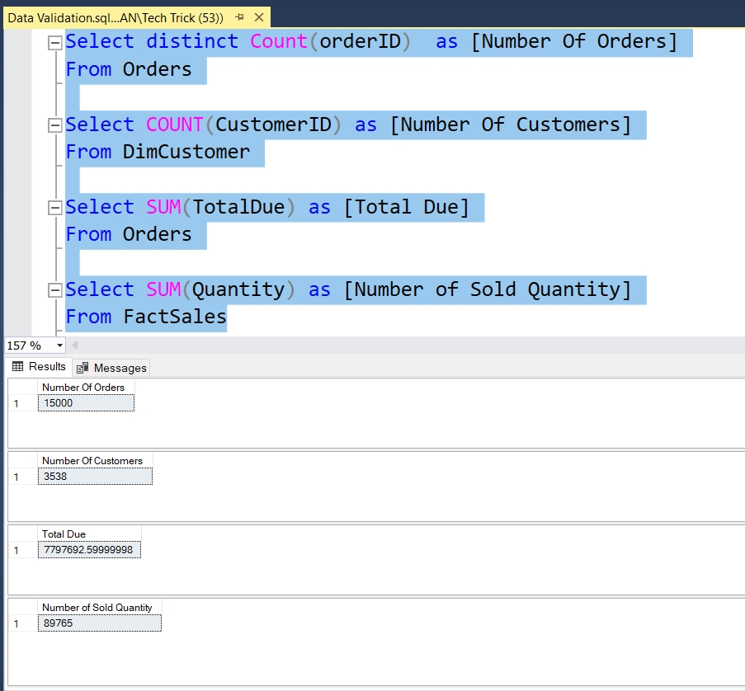
Data Validation & DAX

Slide 21
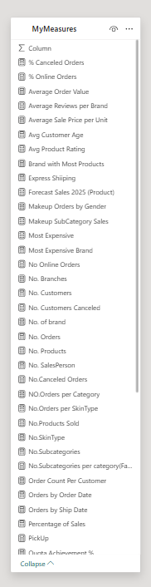
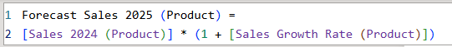
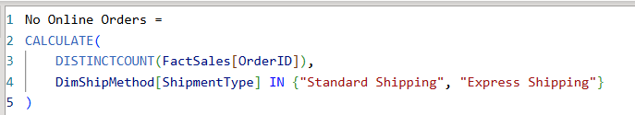
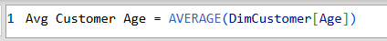
Data Validation & DAX

Slide 22
Power BI Dashboards
Power BI was used to design interactive dashboards covering key areas such as Sales, Products, Overview, Salesperson, Branch, Category, Subcategory, and Brand. These dashboards provide real-time insights through user-friendly visuals, KPIs, and drill-down features, enabling different teams to explore performance metrics and support data-driven decisions.

Slide 23
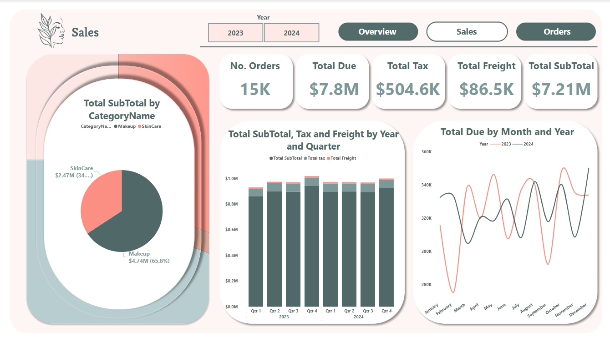
Power BI Dashboards
1.Sales

Slide 24
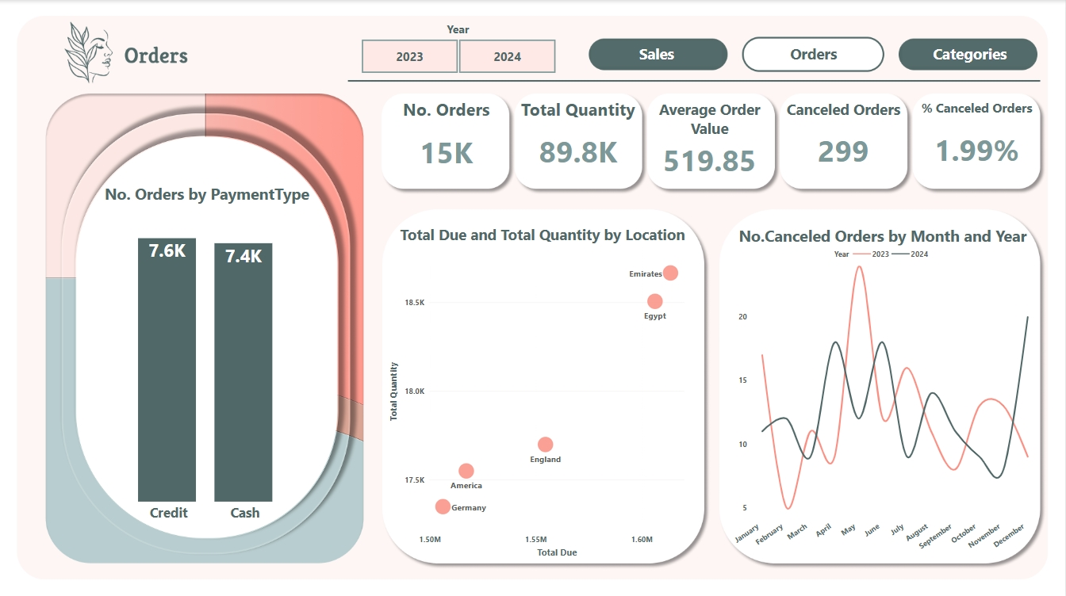
Power BI Dashboards
2.Orders

Slide 25
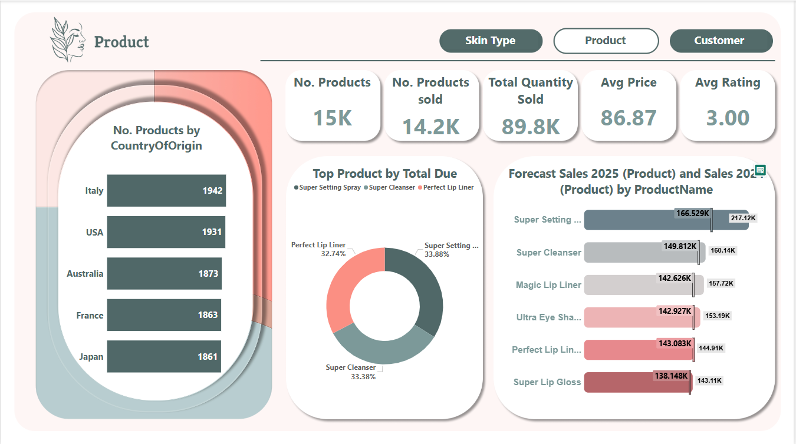
Power BI Dashboards
3.Product

Slide 26
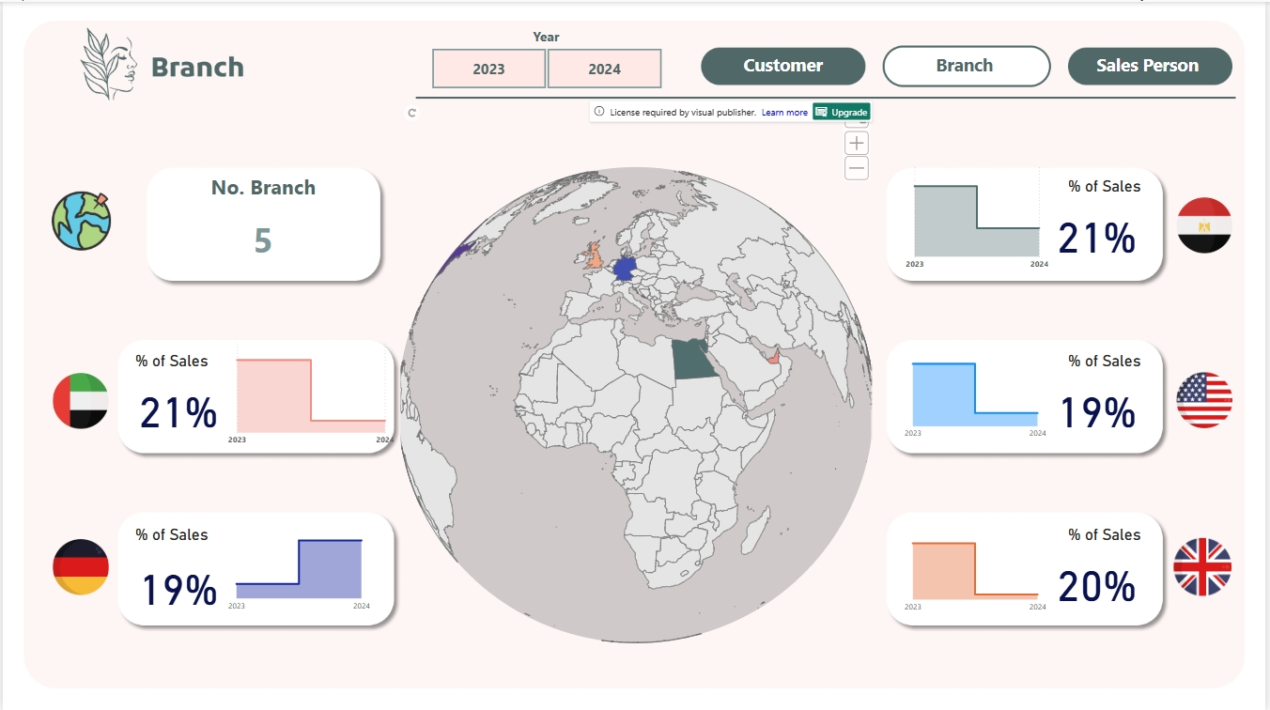
Power BI Dashboards
4.Branches

Slide 27
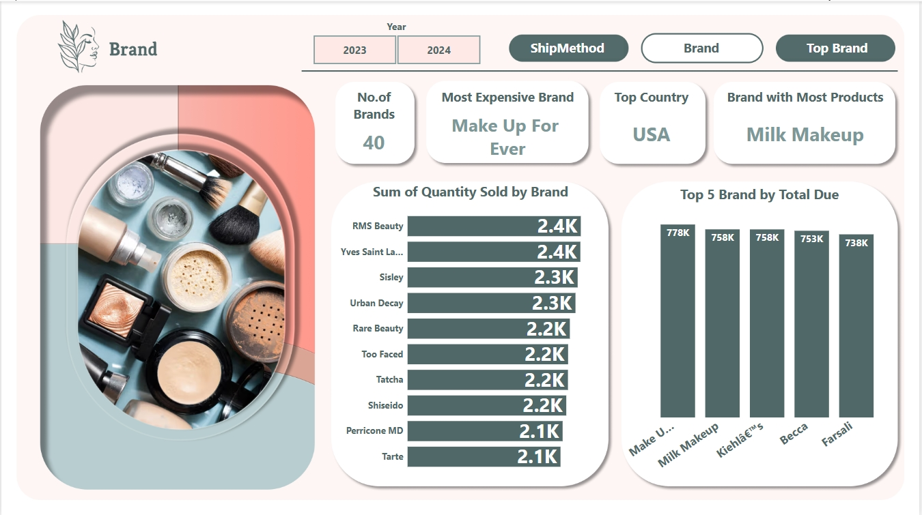
Power BI Dashboards
5.Brands

Slide 28
Reporting Using SSRS
SSRS was used to create dynamic, paginated reports focused on key areas such as Product performance, Salesperson achievements, and Customer segmentation. These reports provided real-time, printable insights using direct queries from the data warehouse, with filters and parameters to support flexible analysis and scheduled delivery.

Slide 29
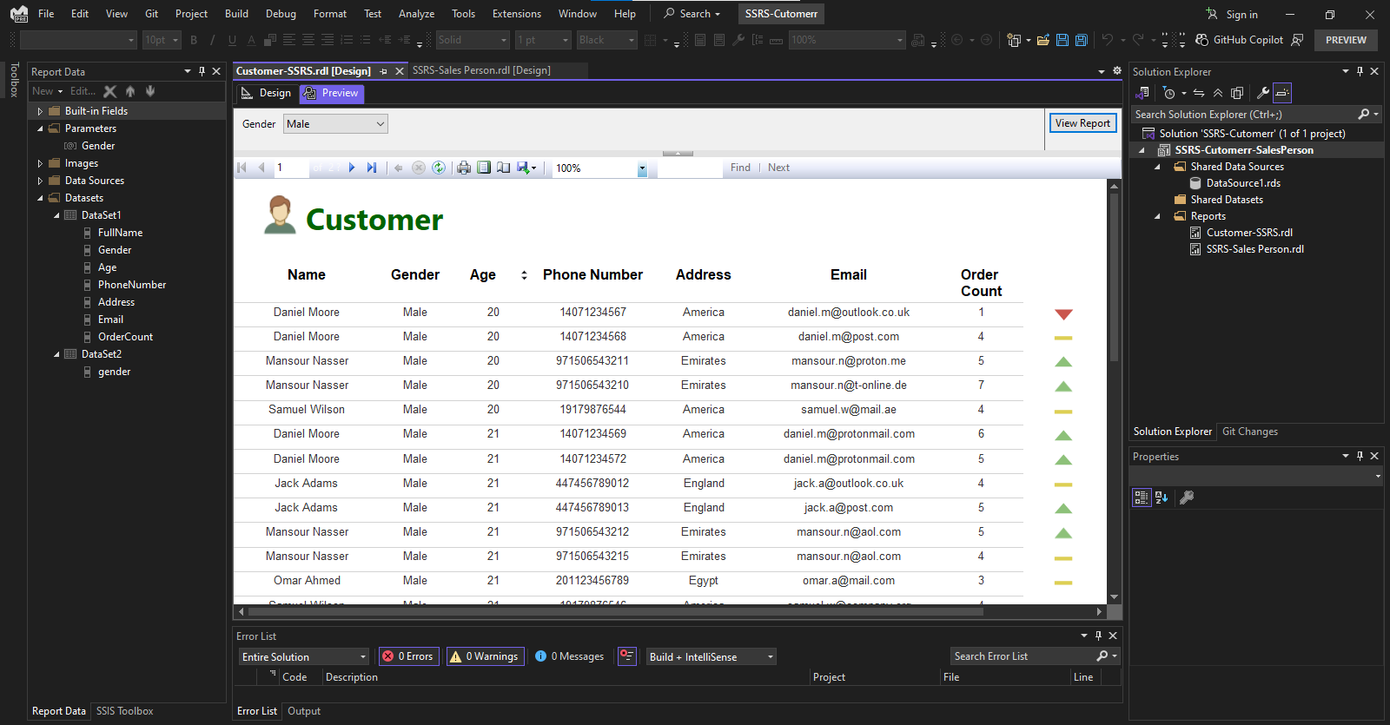
Reporting Using SSRS

Slide 30
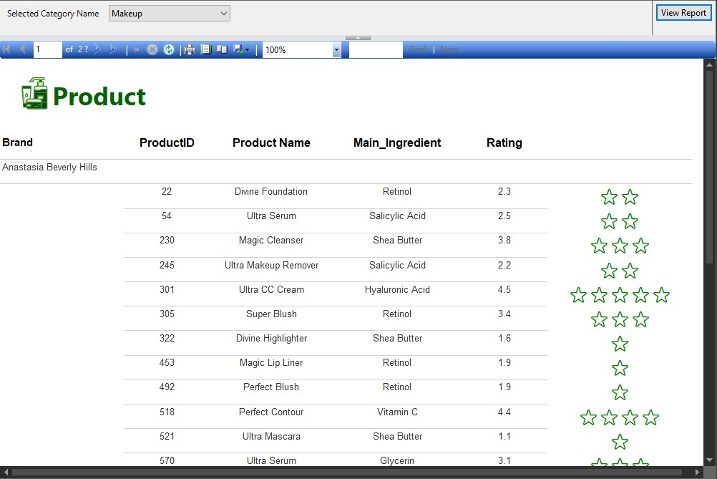
Reporting Using SSRS

Slide 31
Website
A web interface was created to display key analytics and dashboards in one centralized platform. It offers interactive visuals, filters, and summaries from Power BI, allowing internal teams and partners to access real-time insights easily without direct access to BI tools.

Slide 32
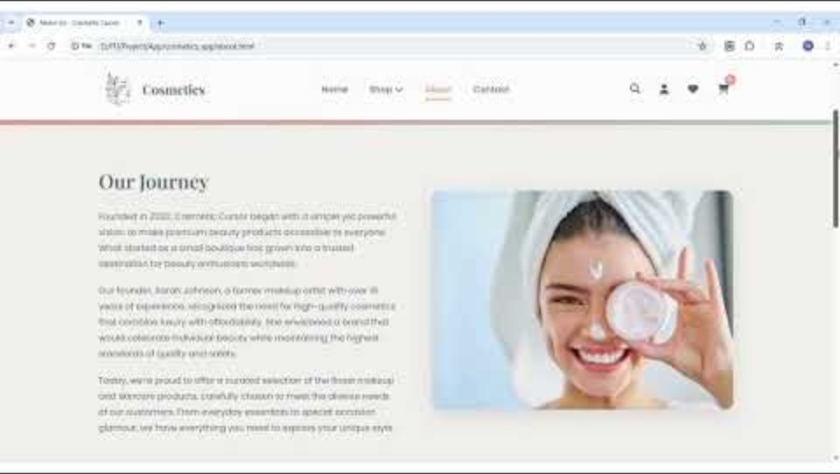
Website

Slide 33






Ahmed Gomaa
Ahmed Ayman
Aliaa El-Sepay
Salma Essam
Mona Ashraf
Thank You

